Slide 1



CSE4062 Introduction to Data Science and Analytics
Machine Learning Approach to Anemia Detection
Group 3
CSE 150121004
CSE 150120043
CHE 150619006
BIO 150820053
Ahmet Arda Nalbant
Umut Bayar
Burçe Peker
Kerem Paçacı
ardanalbant@marun.edu.tr
umutbayar@marun.edu.tr
burcepeker@marun.edu.tr
kerempacacı@marun.edu.tr

Slide 2

Table Of Content
10
03
DBSCAN Analysis
Data Set
11
Apriori Algorithm
04
Data Preprocessing Steps
Feature Selection Methods
13
05
Exploratory Data Analysis (EDA)
Classification Experiments
15
07
K-means Clustering Analysis
17
Confusion Matrices
09
Hierarchical Clustering Analysis
19
Statistical Significance Analysis
02

Slide 3
Anemia Disease Dataset
Our goal is to determine whether a patient has anemia based on their data using various data analysis methods. The dataset consists of 29 attributes and 15302 rows. Important attributes and descriptions about the database can be seen below;
GENDER: The gender of the patient (1 = Male, 2 = Female)
WBC: White blood cell count (x10^3/μL), indicating immune system activity
NE#: Neutrophil count (x10^3/μL), a type of white blood cell that fights infections
RBC: Red blood cell count (x10^6/μL), responsible for oxygen transport
HGB: Hemoglobin level (g/dL), essential for oxygen transport in blood
HCT: Hematocrit (%), the proportion of red blood cells in blood
MCV: Mean corpuscular volume (fL), the average size of red blood cells.
MCH: Mean corpuscular hemoglobin (pg), average hemoglobin amount per red blood cell.
MCHC: Mean corpuscular hemoglobin concentration (g/dL), hemoglobin concentration per red blood cell volume.
B12: Vitamin B12 level (pg/mL), crucial for nerve function and red blood cell formation.
All_Class: Overall classification of anemia (e.g., 4 for anemia, 0 for normal).
HGB_Anemia_Class: Binary label for anemia classification based on hemoglobin levels (1 = anemia, 0 = normal).
Iron_anemia_Class: Binary label for iron deficiency anemia classification (1 = iron deficiency anemia, 0 = normal).
Folate_anemia_Class: Binary label for folate deficiency anemia classification (1 = folate deficiency anemia, 0 = normal).
B12_Anemia_class: Binary label for vitamin B12 deficiency anemia classification (1 = B12 deficiency anemia, 0 = normal).
How to Start?
Consult Us
03

Slide 4
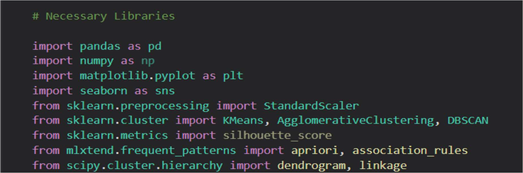
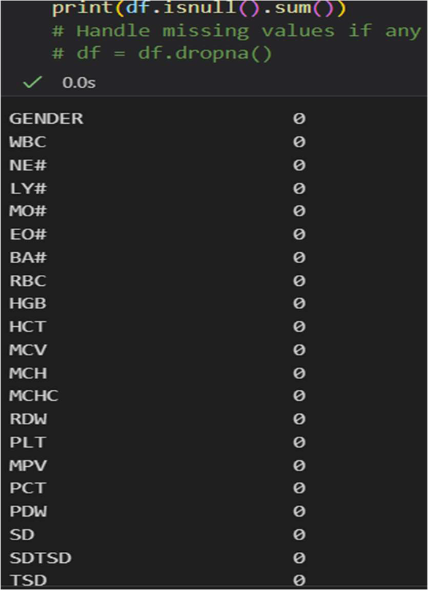
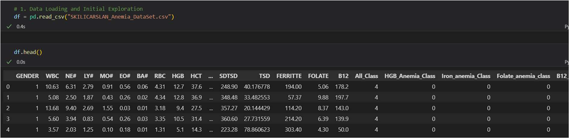
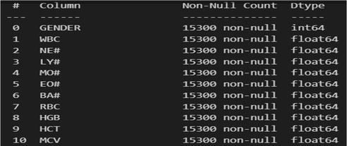
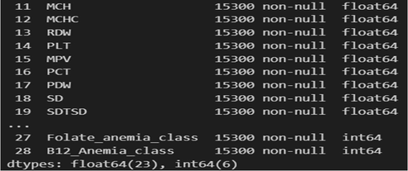
Data Preprocessing Steps
1- Adding libraries.
4- Null variable check.
2- Assigned Dataset: df
3- Data Column Summary: Numeric Variables
04

Slide 5
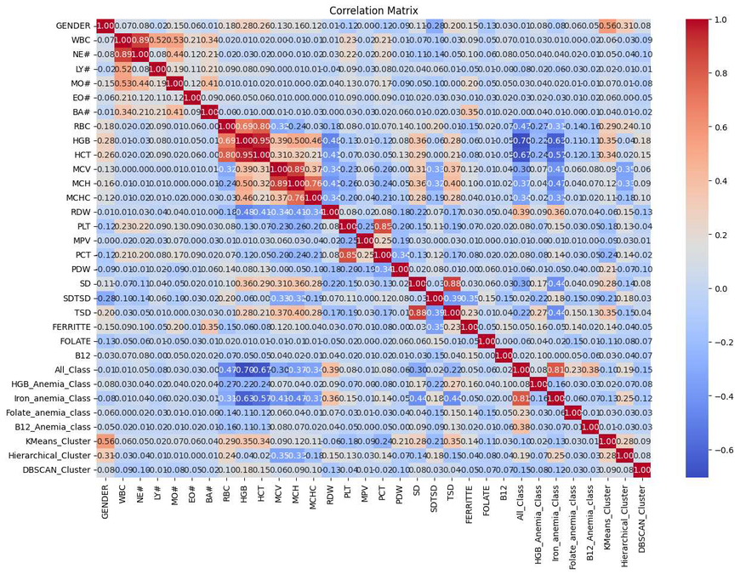
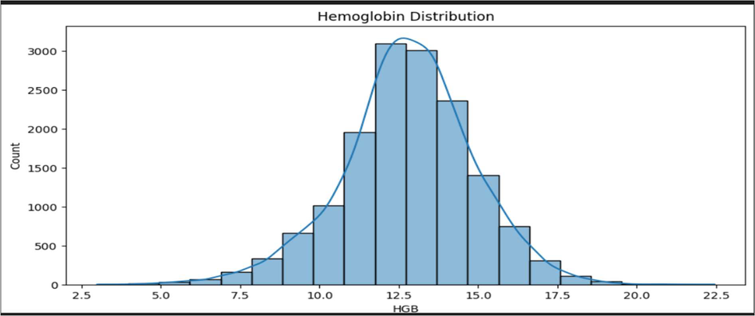


Exploratory Data Analysis (EDA)
1- Hemoglobin Distribution Histogram
2- Correlation Matrix
Approximately normal distribution centered around 13
Most values between 10 and 16
Slight right skew indicates a few individuals with high HGB
Shows pairwise correlations between variables
Identifies redundant features and predictors
Useful for both feature selection and understanding
data
05

Slide 6
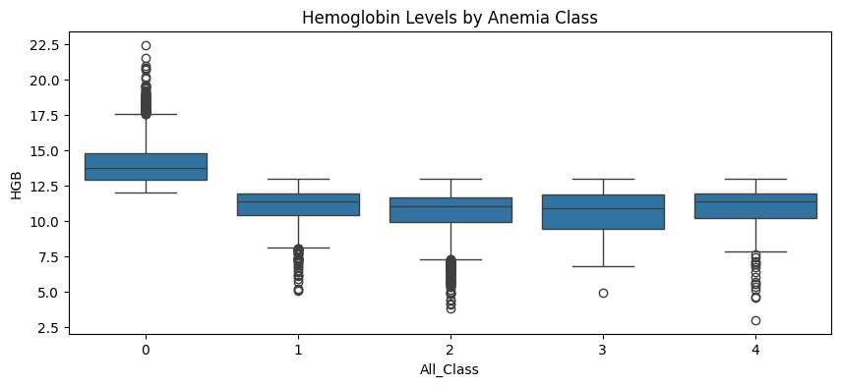

Exploratory Data Analysis (EDA)
3- Hemoglobin levels by Anemia class boxplot
HGB levels decrease as anemia class increases
Class 0 = Healthy, Class 4 = B12 Deficiency
Clear downward trend supports class stratification
06

Slide 7

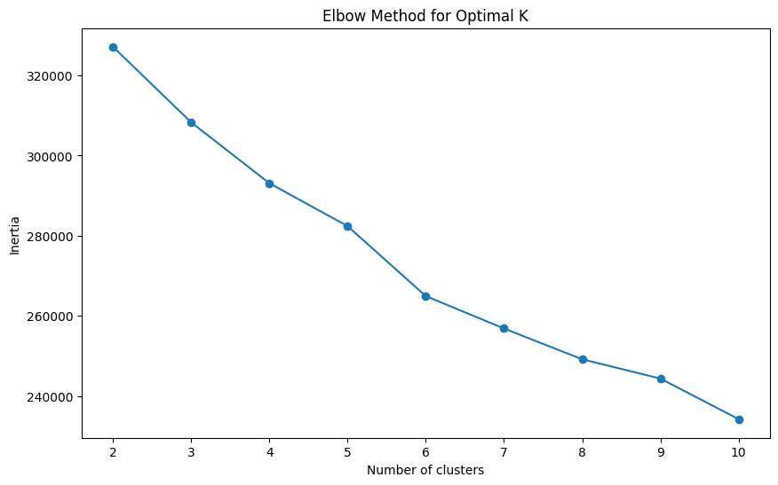
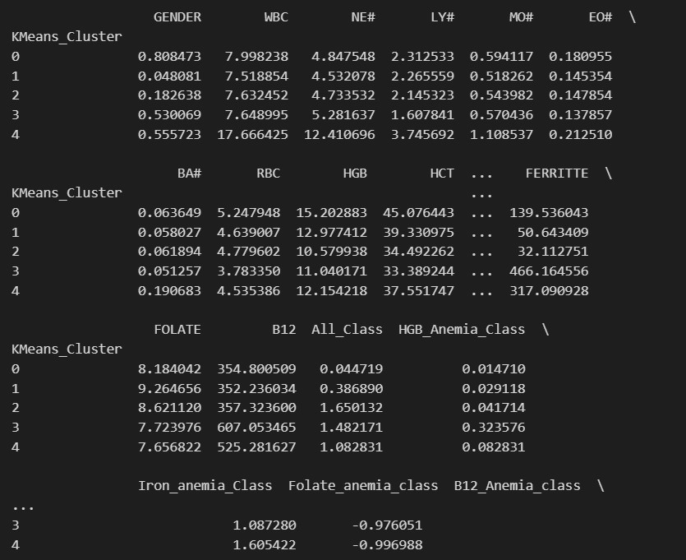
K-means Clustering Analysis
Elbow Graphic for finding optimal K value
The anemia patient population naturally divides into 5 clinically distinct subgroups
Elbow method indicates optimal k = 5
07

Slide 8


K-means Clustering Analysis
Findings
Business & Clinical Action Plan
Priority Patient Triage – Cluster 0 (Healthy Controls): Represents healthy individuals.
3 distinct anemia subtypes identified:
Iron-Deficient
Data: HGB = 15.2, Ferritin = 139.5 → normal blood levels.
Inflammatory
Action: Exclude from routine anemia screening.
EHR Tag: Marked as “GREEN” to indicate no clinical risk or screening priority.
Complex
Benefits
Cluster 2 is the most urgent group
Evidence based clustering
Lowest HGB with iron deficiency
Scalable integration into hospital EHR systems
Cluster 4 represents potential rare disorders or lab errors
Clear and actionable clinical pathways can be established for each patient subgroup
08

Slide 9
Hierarchical Clustering Analysis
Smart Patient Sorting System
Smarter Hospital Spending
Build an automatic warning system to reduce time doctors spend searching for high-risk patients by identifying and prioritizing critical cases
Waste reduction strategy
Cluster 1 (3,818 Patients)
Urgent Cases (Cluster 2&3)
Currently All anemia patients receive the same iron pills, to prevent that:
Lock the patient file in RED
- Prescribe cheap oral iron for mild cases (HGB > 11)
- Reserve expensive IV iron for severe anemia (HGB < 8)
Send SMS alert to the hematology team
Prioritize appointment scheduling
Cluster 4 (Inflammation Group)
Iron Deficiency (Cluster 1)
To avoid ordering iron tests despite high ferritin levels:
Tag file for "Iron Protocol"
✔ Auto-order CRP test
✔ Auto-order Rheumatoid Factor test
✖ Cancel unnecessary iron panel (saves $65 per patient)
Auto-order iron level tests every 3 months
Refer to nutritionist
09

Slide 10
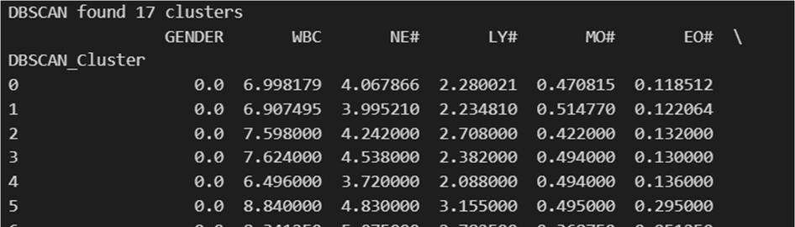
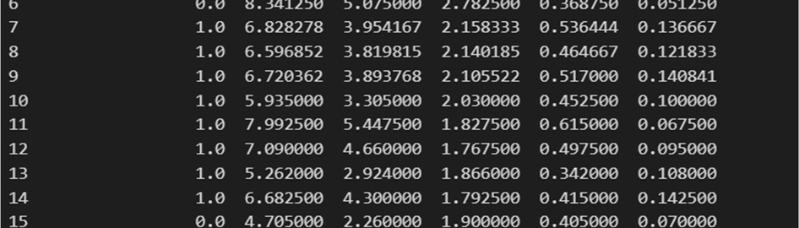
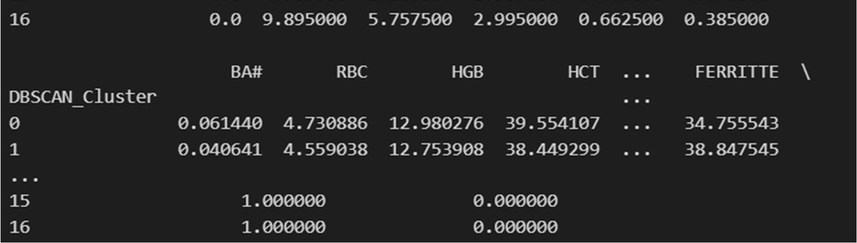
DBSCAN Analysis
Critical Abnormalities
- Cluster 16 (High-Risk): WBC = 9.89, NE# = 5.75, EO# = 0.385 → possible allergy/parasitic cause
- Cluster 13 (Low-Risk): WBC = 5.26, NE# = 2.92
Iron Status Variations
- Cluster 0: Low ferritin (34.75) → Possible iron deficiency
- Cluster 1: Moderate ferritin (38.84) → Borderline status
Clinical Protocols
For Women
For Man
Ferritin <15 + heavy menstrual bleeding → IV iron + gynecology consult
Red Flag: HGB <10 & ferritin <30 → Consider endometrial biopsy
MCV <80 + no GI symptoms → Order celiac serology + 3 fecal occult blood tests
PLT >450 → Rule out myeloproliferative neoplasms
Check PPI use (can cause iron malabsorption)
Strong gender-specific hematologic patterns identified across clusters.
10

Slide 11
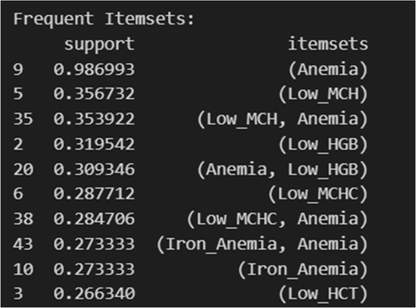
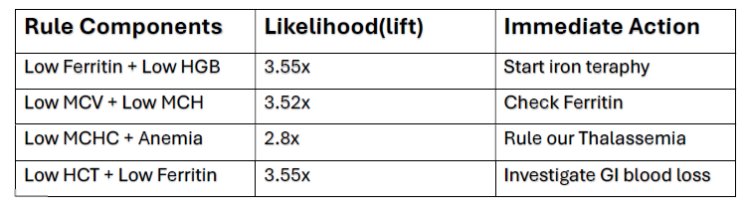
Apriori Algorithm
Binary Conversion: Converts blood test results into binary (1/0) using medical thresholds
Top 5 Most Clinically Significant Patterns
- WBC > 11 → High_WBC = 1
- HGB < 12 → Low_HGB = 1 (anemia threshold)
Iron Deficiency Anemia Signature
Microcytic Anemia Triad
Nutrient Deficiency Flags
- Ferritin < 15 → Iron deficiency
- B12 < 200 → B12 deficiency
Severe Iron Deficiency
Erythrocyte Marker Pattern
Anemia Classification: Uses labeled types (Iron, Folate, B12-related)
Pattern Mining (Apriori Algorithm)
Triple Marker Confirmation
- Identifies frequently co-occurring abnormalities
- Filters patterns with ≥10% support (min_support = 0.1)
- Limits output to max 4 abnormalities per rule for readability
Clinical Decision Support Table
Top 10 most common abnormality combinations by frequency
11

Slide 12
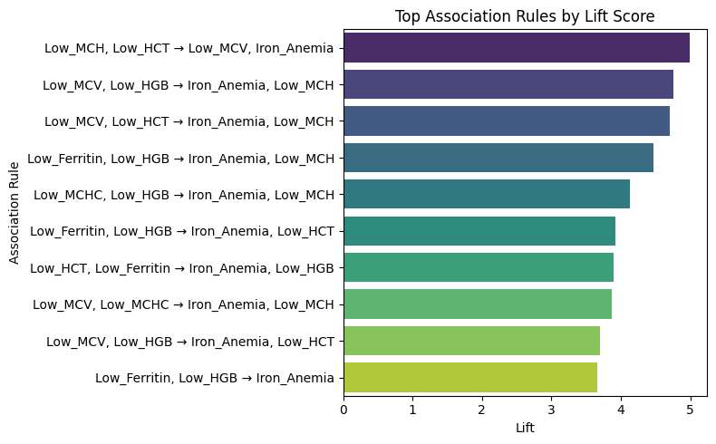
Apriori Algorithm
Top Association Rules By Lift Score
Most Predictive Combinations
Low Ferritin + Low HGB → Start iron therapy
Low MCV + Low MCH → Check ferritin
Low MCHC + Anemia → Rule out Thalassemia
Low HCT + Low Ferritin → Investigate GI blood loss
Clinical Utility
Reduce unnecessary tests
Accelerate treatment decisions
Improve accuracy in anemia classification
12

Slide 13
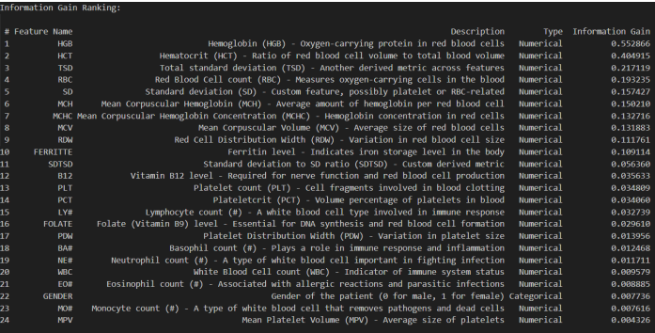
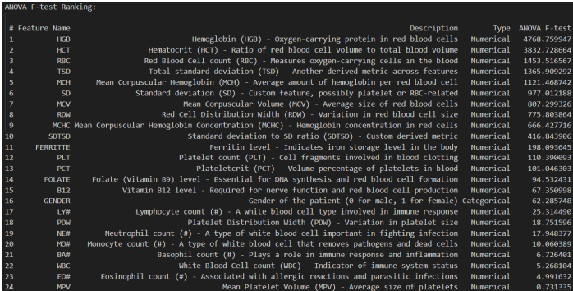
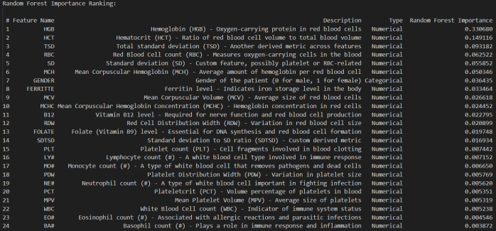
Feature Selection Methods
Information Gain
ANOVA F-Value
Random Forest Importance
13

Slide 14
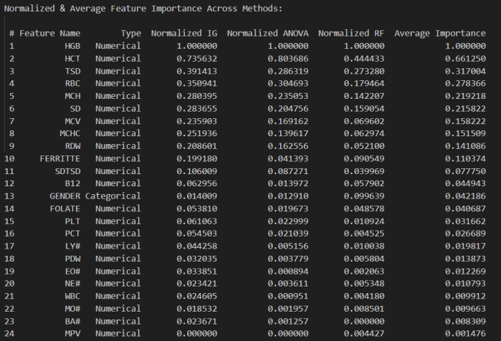
Normalization of Feature Selection Methods
To conclude we choose our best 23 attributes after normalizing these 3 feature subset selection methods results and taking their average values, due to our threshold value being 0.005 we dropped the MPV column from our data.
14

Slide 15
Classification Experiments
In this experiment, we performed classification using various supervised learning algorithms. We did not use Cross Validation or other re-sampling techniques. Instead, we split the dataset as 30% test data and 70% train data.
Methods Used for Classification
Performance Evaluation
K-Nearest Neighbors (KNN) with k=3 and k=9
Accuracy
Decision Tree Classifiers:
-With Gini Index
-With Entropy (Information Gain)
F1 Score (Macro & Micro)
-Macro: Average F1 score across
all classes, treating them equally.
-Micro: F1 score calculated
globally by counting total true
positives, false negatives, and
false positives.
Naïve Bayes (GaussianNB)
Artificial Neural Networks (MLPClassifier):
-1 Hidden Layer with 10 neurons.
-2 Hidden Layers with 10 neurons each.
AUC (Area Under the ROC Curve)
Support Vector Machine (SVM)
All classifiers that benefit from standardized data (e.g., KNN, SVM, MLP) were trained using scaled feature values, achieved with StandardScaler.
Additionally, ROC curves were plotted for all classifiers. In the multiclass setting, micro-averaged ROC curves are shown.
15

Slide 16
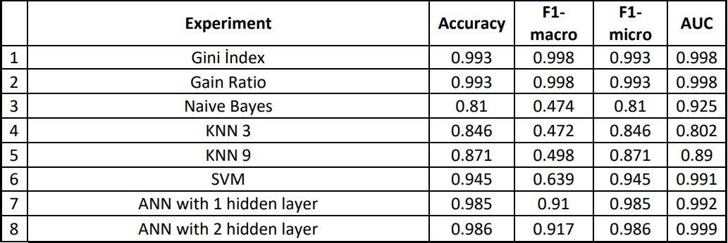
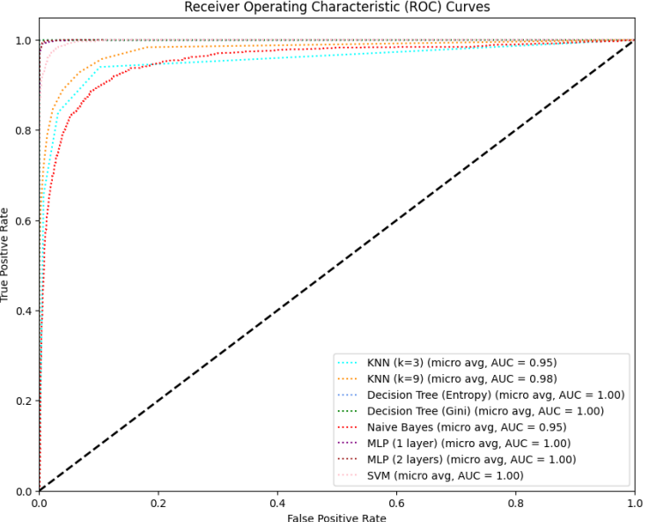
Evaluation for Classification Experiments
The most accurate method is decision tree methods (Gini Index and Gain Ratio).
ANN with 2 hidden layer over performs when compared with decision tree methods considering AUC.
Also, F1-micro and F1-macro suggests decision tree methods performs better.
The ROC curve shows the trade-off between sensitivity and specificity. Classifiers that give curves closer to the top-left corner indicate a better performance. The closer the curve comes to the 45-degree diagonal of the ROC space, the less accurate the test. This also shows decision tree methods (Gini Index and Gain Ratio) are the best performing method followed by ANN with 2 hidden layers.
16

Slide 17
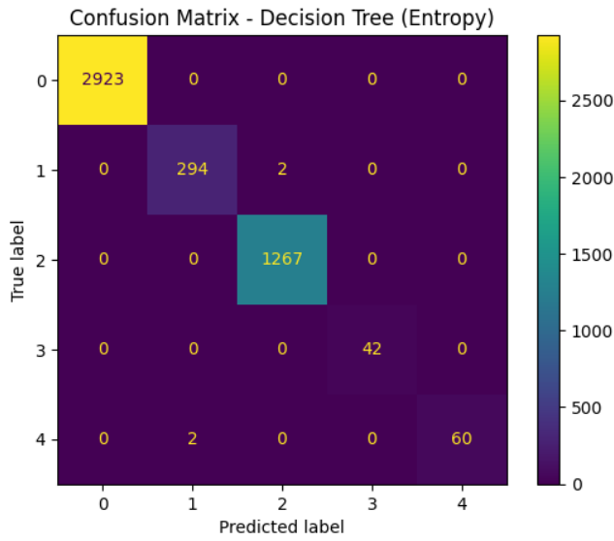
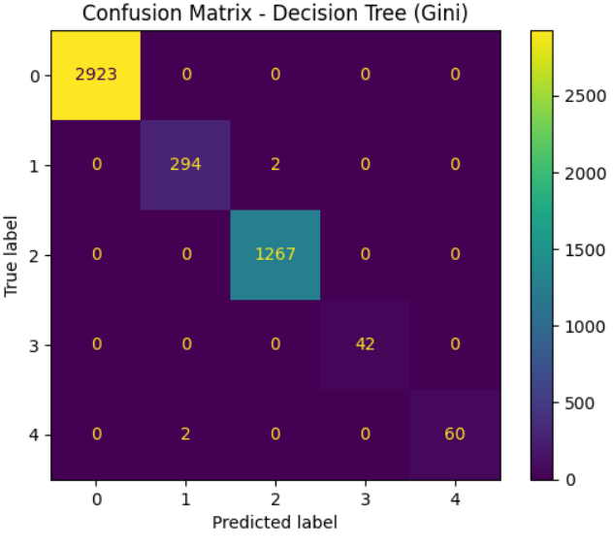
Confusion Matrices
17

Slide 18
Confusion Matrices Summary
Our confusion matrix is 5 by 5 due to our target column’s values are not only binary but in a range from 0 to 4.
0 is healthy
1 is HGB Anemia
2 is Iron Anemia
3 is Folate Anemia
4 is B12 Anemia
According to the matrices in the previous page, it is observed that the Decision Tree classifiers using Entropy and Gini Index all achieved nearly identical performance based on their confusion matrices.
For instance, in the Entropy-based decision tree, the model predicted true positive cases 2923 times for Class 0 out of 2923 actual cases, and 1267 true positives for Class 2 out of 1267 actual cases—indicating perfect classification for these classes.
The only minor misclassifications are seen in Class 1 and Class 4, where 2 instances were misclassified each. This suggests that the model is classifying with extremely high accuracy across all classes, possibly exceeding 99% overall accuracy. While machine learning models rarely achieve perfection due to noise or outliers, in this case the performance is nearly flawless.
18

Slide 19
Statistical Significance Analysis
Analysis was performed between the best performing model which was Decision Tree (Gini Index) and its closest competititor ANN with 2 hidden layer.
Accuracy
The P-value is = 0.00001
The t-statistics is = 17.886
F1-Macro
The P-value is = 0.00001
The t-statistics is = 13.464
F1-Micro
The P-value is = 0.00001
The t-statistics is = 13.464
Since p<0.05, null-hypothesis can be rejected in terms of accuracy, F1-Macro and F1-Micro that both models perform equally well on this dataset. We may conclude that the two algorithms are significantly different.
AUC:
The P-value is = 0.2853
The t-statistics is = 1.136
Since p>0.05, null-hypothesis cannot be rejected in terms of AUC and may conclude that the performance of the two algorithms is not significantly different.
19

Slide 20
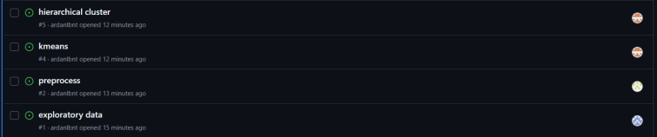
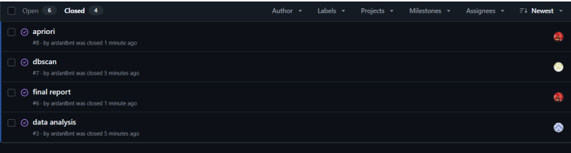
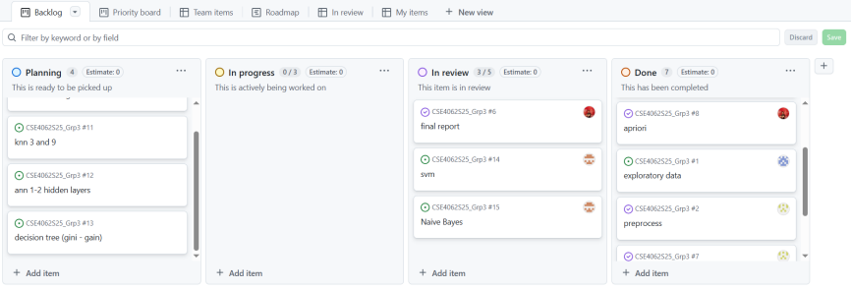
Task Assignment with KANBAN
We used the KANBAN method for task management. As shown in the first image, we defined the issues and distributed the tasks among our team members.
Afterwards, we marked the completed tasks as "Done" and closed the issues. This allowed for a more balanced and efficient project collaboration
This is KANBAN version of our task assignment
19

